Slide 1

Building Strong Relationships for Donor Retention
San Diego Food Bank
June 13, 2019

Slide 2
Who are we talking about?
Individuals
Families
Clubs/Circles/Groups
Foundations
Corporations/Businesses
Notes:
Fundraising Effectiveness Project
Annual report of Association of Fundraising Professionals and the Center on Nonprofits and Philanthropy at the Urban Institute
Average donor retention rate under 50% last ten years.
Data of 13,600 nonprofits

Slide 3

Why focus on donor retention?

Slide 4
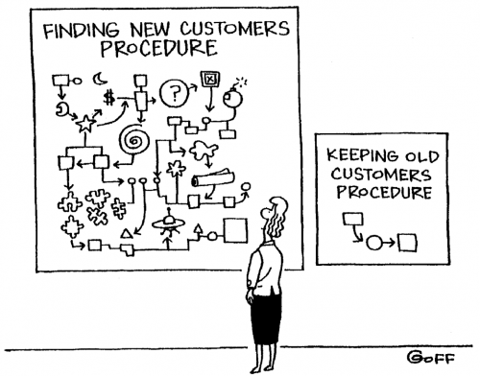

Slide 5

2018 Donor Retention Rates
Average: 37%
First-time: 21%
Repeat: 57%
Reactivated: 37%
Notes:
Fundraising Effectiveness Project
Annual report of Association of Fundraising Professionals and the Center on Nonprofits and Philanthropy at the Urban Institute
Average donor retention rate under 50% last ten years.
Data of 13,600 nonprofits

Slide 6

Cost of Donor Acquisition
Expensive
.25 to $1.50 to raise $1
$100 gift could cost $25 to $150 to raise

Slide 7

Why do donors stay?

Slide 8

Why do donors stay?
Organization produces & shows outcomes
Know what to expect in interactions
Receive timely thank you notes
Opportunities to make views known
Feel part of an important cause
Feel appreciated
Notes:
2011 Report by the organization Donor Voice.

Slide 9

Why do donors leave?
Poor service or communication
Thought organization didn’t need them
Never thanked
Unsure of how money was used
Thought other groups more deserving
Could no longer afford

Slide 10

Build relationship
Gift = step in relationship not a just a business transaction
Elements of healthy relationship
Make a priority
Respect
Trust
Good communication
Care deeply
Value kindness
Course correct at a moment’s notice

Slide 11

Plan
Create a plan with consistent action
Just call to say thank you/share organization highlight
Email article of interest
Ask a favor- “Like” on Facebook page
Social media and newsletter mentions
Schedule contacts
Keep good records

Slide 12
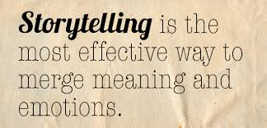
Share impact with stories

Slide 13
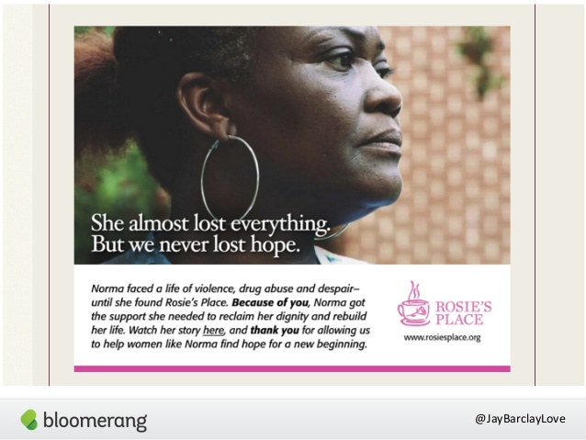

Slide 14
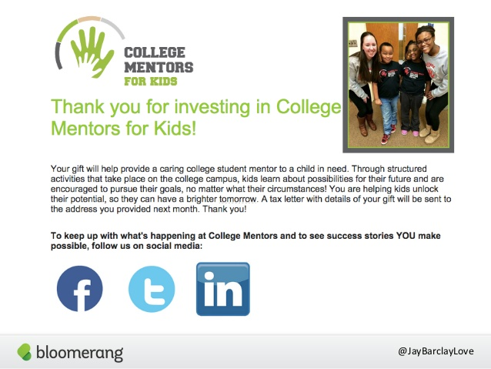

Slide 15

Ask donors for feedback

Slide 16
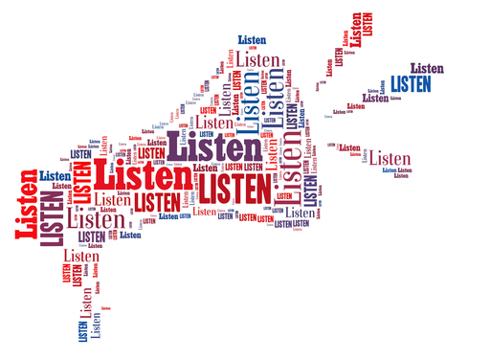
Focus Groups Individual Interviews Surveys
Know what/why asking
What will you do with feedback?
System to record, analyze, share and make changes based on feedback.

Slide 17

Donor feedback
What prompted your first gift?
Why do you continue to give?
What is your connection to the cause?
What would you like to hear from us?
Tell us your stories.
Donor advisory board

Slide 18
Sharyn Goodson Vice President, Philanthropy Leichtag Foundation sharyn@leichtag.org (760) 487-1532

