Slide 1

Food Bank University
Donor Prospecting & Grant Writing
April 2019
The Jacobs & Cushman San Diego Food Bank

Slide 2

Case for support
        Based on community need
        Unique solutions
        Evidence of impact
        Quantifiable outcomes
        Budget
        Explains funding need
        Inspires action

Slide 3

Why Prospect?
        Donors leave despite best efforts
        Average donor retention rate < 50%
        5 prospects to 1 gift
        Risk overdoing it with same people
        Need steady stream of opportunities

Slide 4

Finding new donors
      Individuals account for 90% of most nonprofit funding
      70% of Americans give
      Most by lower/middle income households
      Typical household supports 5 – 10 nonprofits each year
      Surrounded by potential donors!

Slide 5
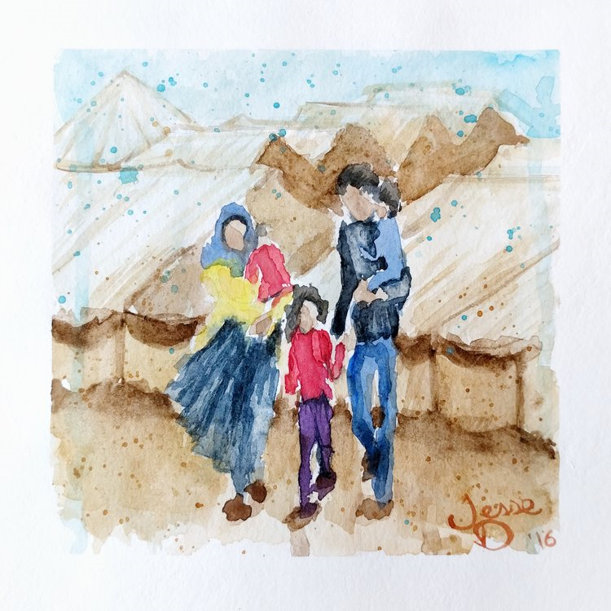
Prospecting A-B-C
        Access via existing relationship
        Belief in your cause (or potential)
        Capacity to give

Slide 6

Who loves you?
      Board
      Existing Donors
      Volunteers
      Clients
      Government Reps
      Vendors
People 3x more likely to give when referred by friend/contact

Slide 7

Community Education
      Groups/Clubs: Rotary, Kiwanis, Garden Clubs, Women’s Clubs
      Chambers of Commerce
      Libraries
      Houses of Worship
      Retirement Communities
      Community Centers
      Share materials, gather contact info, follow-up
  Seek out retirees

Slide 8

Prospect follow-up
        Build relationship – ask about them
        Multiple (7 average) touches
        Call/email that you enjoyed meeting
        Invite for a visit
        Send articles on community need
        Suggest volunteering
        Have others reach out

Slide 9

Outstanding Proposals
Meets guidelines: request type, population and geographic area served, funding amount requested
All questions directly & completely answered
Meets: # of pages, word/character count, font, margins, etc.
Convey emotion & urgency
Submitted on time or early!

Slide 10

Outstanding proposal elements
Demonstrated capacity for the grant
  Staff & leadership
  Infrastructure
  Volunteer support
Funding demand is great
  Clear case for support
  Numbers and data used for context – more recent the better

Slide 11

Outstanding proposal elements
Goals & Outcomes
  Clear
  Realistic
  Measurable
  Specific plan to achieve
Quality & Impact
  How do you know?
  How do you make needed changes?

Slide 12

Outstanding proposal elements
Demonstrate sustainability
  Funding sources
  Capacity and plans to raise funds
Budget
  Reasonable costs
  Revenue sources
  Deficit explained

Slide 13

Power in testimonials
“Our physician recently told us to eat more fresh vegetables. We want to but good produce is very expensive. For us, the weekly produce donations are an answer to our prayers.”
“I didn’t know what love really felt like or even have food to eat. The support is endless.”
“I couldn’t have made it to where I am today without the support I’ve received. I’m forever grateful.”

Slide 14

When You Get Funding
Thank right away – before you deposit the check
Acknowledge per directions
Clarify expectations
Communicate regularly
Submit reports early
Follow-up before the funder does
Notes:
a story of an organization that excels with stewardship and post-grant communications

Slide 15

Grant declined
Disappointing but common
Average success rate for first approach – 12 to 20%
Recheck assumptions in applying
Thank & ask for feedback
  Done something differently?
  Apply again & if so, when?
  Suggestions of other funders?
Keep communicating!
Only “no” for now
Notes:
a story of an organization that excels with stewardship and post-grant communications

Slide 16
Thank you!
Sharyn Goodson
Vice President, Philanthropy
Leichtag Foundation
sharyn@leichtag.org

